Slide 1

K. J. Somaiya Institute of Technology, Mumbai
Department of Computer Engineering A.Y. 2024-25
Transforming Landscapes: Potential Impact of Land Use Land Cover (LULC) on Air Quality
Guide: Dr. Jyoti Wadmare
LY-A
Palak Desai – 10
Kapil Bhatia – 55
Dakshita Kolte – 65

Slide 2

ABSTRACT
Understanding the impact of land use and land cover (LULC) changes on air quality and public health is crucial for effective environmental management and policy-making. This study investigates how variations in LULC influence air quality and the subsequent effects on public health. A comprehensive machine learning model is used to predict future air quality trends based on LULC data. The model utilizes a detailed dataset to classify land cover types and their impacts on air quality, providing predictive insights into future air quality scenarios. The study will also evaluate how changes in air quality resulting from LULC variations affect public health outcomes. By integrating these analyses, the research aims to provide a deeper understanding of the dynamic relationships between LULC changes, air quality, and public health, ultimately supporting more informed decision-making and proactive environmental strategies.

Slide 3
PROBLEM STATEMENT:
Land Use and Land Cover (LULC) analysis involves studying the physical characteristics of the Earth's surface and how these areas are utilized by human activities. Analyzing historical LULC changes provides insights into how urbanization, deforestation, and agricultural expansion have shaped landscapes and impacted ecosystems, biodiversity, climate, and air quality. Tools like satellite imagery, GIS, and machine learning models enable the detection and quantification of these changes, helping to predict future trends and assess their environmental and public health implications. Understanding LULC dynamics is crucial for effective environmental management, policy-making, and improving air quality forecasts.

Slide 4
OBJECTIVES:
1) Collect and prepare a dataset, classify specific land cover types and their impact on air quality, and create a custom dashboard for visualization.
2) Build a machine learning model based on land use land cover classification to predict future air quality changes.
3) Evaluate the performance and future predictions of the developed custom machine learning model to assess its impact on air quality.
4) Assess the impact of air quality changes on public health.

Slide 5
LITERATURE SURVEY
Reference No. | Our Understanding | Methodology Used | Dataset Used | Gaps in Existing System
[1] | Investigates LULC changes on air quality in Gujarat using satellite data and Google Earth Engine. Highlights need for advanced technologies. | Acquire and preprocess Sentinel-2 tiles, create training/testing samples, implement sampling strategies, train and evaluate classifiers, and assess accuracy. | Sentinel-5P MODIS Landsat-8 | Limited geographic coverage, outdated techniques
[2] | Collect remote sensing and GIS data, apply CA-Markov model for LULC predictions, create thematic maps, analyze transitions and probabilities, and validate with Kappa Index. | Collect Landsat data (2010, 2020), create LULC maps with ArcGIS, apply CA-Markov model for future scenarios (2030-2100), use transition matrices and probability vectors for predictions. | Landsat-ETM+ based 2010 and Landsat-OLI based 2020 data | Dependency on historical data, limited socio-economic factors
[3] | Investigates LULC changes in Zambia using CA-Markov model. Highlights need for advanced models and addressing data scarcity. | Collect remote sensing and GIS data, apply CA-Markov model for LULC predictions, create thematic maps, analyze transitions and probabilities, and validate with Kappa Index. | ESA CCI land cover maps from 2000, 2010, and 2020 | Insufficient dataset integration, need for advanced algorithms
[4] | Addresses LULC mapping in Sudan using Google Earth Engine and CA-ANN model. Emphasizes impact of human activities on LULC changes. | Collect Landsat imagery, classify with Random Forest in Google Earth Engine, analyze LULC changes, and predict future trends using the CA-ANN model. | LULC maps for 2000, 2010, and 2020 provided by Copernicus Climate Data Store | Inconsistent LULC mapping standards, lack of automation

Slide 6
Reference No. | Our Understanding | Methodology Used | Dataset Used | Gaps in Existing System
[5] | Examines LULC changes in Wabe-Shebele river basin using CA-Markov model. Emphasizes need for sustainable land management. | Collect remote sensing and GIS data, apply CA-Markov model, analyze with GIS and image processing, and validate with Kappa indices. | Landsat TM for 1992 Landsat ETM+ for 2007 Landsat-8 OLI for 2022 | Inconsistent LULC mapping standards, lack of automation
[6] | Investigates LULC changes in Thimphu using CA-Markov model. Highlights need for improved policy frameworks. | Collect historical LULC data and field observations, apply CA-Markov model for simulation and prediction, and validate with Kappa indices. | Landsat 7 and 8 | Limited integration of socio-economic factors, need for high-resolution data
[7] | Analyzes machine learning models to predict PM10 levels in Sri Lanka. Highlights need for robust models and efficient hyperparameter optimization. | Data collection and cleaning, correlation analysis, data scaling using MinMax Scaler, selection and training of various machine learning models, hyperparameter tuning, performance evaluation using multiple indices. | Hourly data (1/1/2019 - 31/5/2021) for Battaramulla and Kandy, Sri Lanka: temperature, humidity, solar radiation, rainfall, wind speed/direction, and O3, CO, NO2, SO2, PM2.5, PM10 concentrations. | Insufficient dataset integration, need for advanced algorithms

Slide 7
Reference No. | Our Understanding | Methodology Used | Dataset Used | Gaps in Existing System
[8] | Evaluates sampling designs' impact on machine learning classifiers for LULC classification using Sentinel-2 data. Emphasizes the importance of sampling strategies. | Collect remote sensing and GIS data, apply CA-Markov model, analyze with GIS and image processing, and validate with Kappa indices. | Sentinel-2 data (10m spatial resolution) Study area: Dehradun district, Uttarakhand, India Data acquired on 12 January 2021 | Lack of comprehensive evaluation of sampling designs' impact on classifier performance
[9] | Assesses impact of LULC changes on evapotranspiration in Maharashtra using Google Earth Engine and CART model. Highlights need for high-resolution data and accuracy. | Collect historical LULC data and field observations, apply CA-Markov model for simulation and prediction, and validate with Kappa indices. | Landsat-8 OLI images for the winter seasons from 2018 to 2022 in Akola Block, Maharashtra, India. | Insufficient temporal resolution, inadequate spatial accuracy
[10] | The paper studies Mathura, India (1990-2020) using Landsat images and GIS. It finds increased urban and agricultural areas, decreased water bodies, and reduced forest cover, highlighting the need for better land management. | The methodology includes pre-processing the images, classifying LULC using Random Forest, and analyzing changes with GIS. | Landsat-5, 7, and 8 OLI (USGS) images | Better dataset pre-processing, reduced processing power, overcoming weather impacts, simplifying complex methods, and addressing errors from dynamic environments.

Slide 8
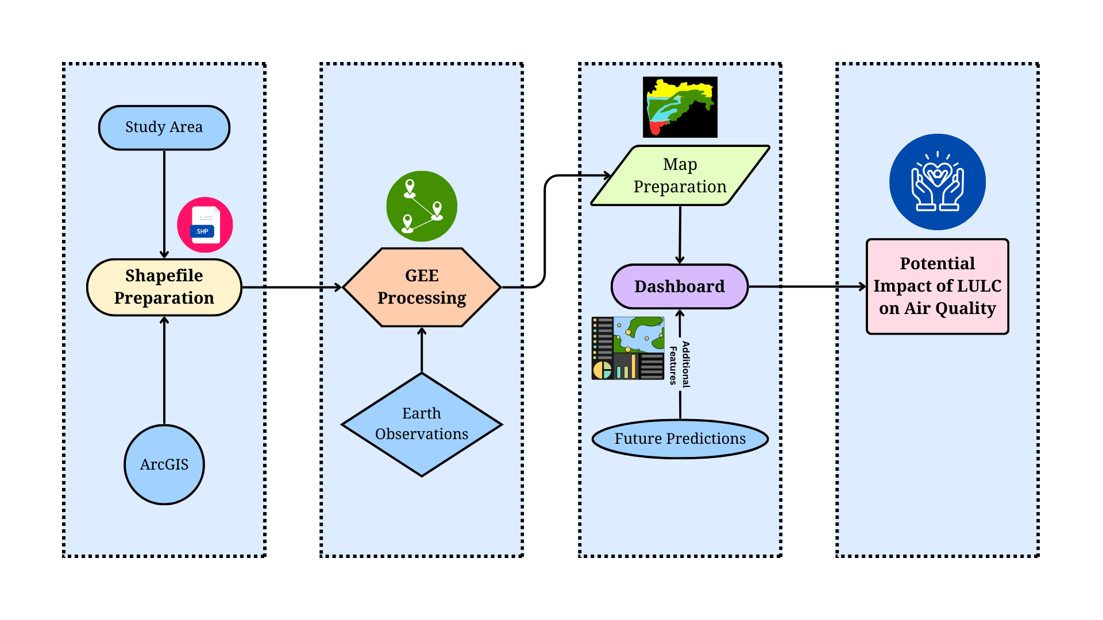
IMPLEMENTATION PLAN AND FLOWCHART

Slide 9
GANTT CHART
Transforming Landscapes: Potential Impact of Land Use Land Cover (LULC) on Air Quality

Slide 10
CONCLUSION
This study will highlight the significant impact of land use and land cover (LULC) changes on air quality and public health. By developing a comprehensive machine learning model, we will successfully predict future air quality trends based on detailed LULC data. The model's ability to classify land cover types and their specific impacts on air quality will provide valuable predictive insights for future scenarios. Through this research, we will demonstrate the dynamic relationship between LULC changes, air quality, and public health outcomes. Our findings will emphasize the necessity for informed decision-making and proactive environmental strategies to mitigate negative effects. By integrating air quality and public health considerations into environmental management, policymakers will be better equipped to address the challenges posed by LULC changes and improve overall community well-being.

Slide 11
REFERENCES
[1] K. H. Jodhani et al., “Synergizing google earth engine and earth observations for potential impact of land use land cover on air quality,” Results in engineering, vol. 22, pp. 102039–102039, Jun. 2024, doi: https://doi.org/10.1016/j.rineng.2024.102039.
[2] Ajay Kumar Taloor, S. Sharma, Gurnam Parsad, and Rakesh Jasrotia, “Land use land cover simulation using integrated CA-Markov model in the Tawi Basin of Jammu and Kashmir India,” Geosystems and Geoenvironment, vol. 3, no. 2, pp. 100268–100268, May 2024, doi: https://doi.org/10.1016/j.geogeo.2024.100268.
[3] Chisanga, C.B., Phiri, D. & Mubanga, K.H. Multi-decade land cover/land use dynamics and future predictions for Zambia: 2000–2030. Discov Environ 2, 38 (2024). https://doi.org/10.1007/s44274-024-00066-w
[4] Osman MAA, Abdel-Rahman EM, Onono JO, Olaka LA, Elhag MM, Adan M, Tonnang HEZ. Mapping, intensities and future prediction of land use/land cover dynamics using google earth engine and CA- artificial neural network model. PLoS One. 2023 Jul 24;18(7):e0288694. doi: 10.1371/journal.pone.0288694. PMID: 37486922; PMCID: PMC10365312.
[5] S. Beshir, A. Moges, and Mihret Dananto, “Trend analysis, past dynamics and future prediction of land use and land cover change in upper Wabe-Shebele river basin,” Heliyon, vol. 9, no. 9, pp. e19128–e19128, Sep. 2023, doi: https://doi.org/10.1016/j.heliyon.2023.e19128.
‌
[6] S. W. Wang, L. Munkhnasan, and W.-K. Lee, “Land use and land cover change detection and prediction in Bhutan’s high altitude city of Thimphu, using cellular automata and Markov chain,” Environmental Challenges, vol. 2, p. 100017, Jan. 2021, doi: https://doi.org/10.1016/j.envc.2020.100017.
[7] L. Mampitiya, N. Rathnayake, Y. Hoshino, and U. Rathnayake, “Forecasting PM10 levels in Sri Lanka: A comparative analysis of machine learning models PM10,” Journal of Hazardous Materials Advances, vol. 13, p. 100395, Feb. 2024, doi: https://doi.org/10.1016/j.hazadv.2023.100395.
[8] Rawat, S., & Saini, R. (2023). Evaluating the impact of sampling designs on the performance of machine learning techniques for land use land cover classification using Sentinel-2 data. International Journal of Remote Sensing, 44(24), 7889–7908. https://doi.org/10.1080/01431161.2023.2290994
[9] Pande, C. B., Diwate, P., Orimoloye, I. R., Sidek, L. M., Pratap Mishra, A., Moharir, K. N., … Tolche, A. D. (2023). Impact of land use/land cover changes on evapotranspiration and model accuracy using Google Earth engine and classification and regression tree modeling. Geomatics, Natural Hazards and Risk, 15(1). https://doi.org/10.1080/19475705.2023.2290350
[10] Gupta P, Singh SK, Gupta P, Kanga S, Mishra VN. (2023) Application of Remote Sensing and GIS Techniques for Identification of Changes in Land Use and Land Cover (LULC): A Case Study. Indian Journal of Science and Technology. 16(46): 4456-4468. https://doi.org/10.17485/IJST/v16i46.2530

Slide 12
THANK YOU!!!

